Slide 1
PLP 2001C Plant Pathology
Dr. Javier GarceS
Office: Wc1-136
PHONE: (407)582-1820

Slide 2
Plant Pathology
“Science that studies plant diseases and attempts to improve the chances of survival of plants when they are faced with unfavorable environmental conditions and parasitic microorganisms that cause disease.”
Estimated that diseases, insects, and weeds annually interfere with or destroy 31-42% of all crops produced worldwide
Of the 36.5% average of total loss
14.1% caused by diseases
12.2% caused by weeds
10.2% caused by insects

Slide 3
Crop Losses, cont’d
Total annual loss estimated at $220 billion
Additional 6-12% loss after harvest (post-harvest diseases)
“Duty and goal of plant pathology to balance all the factors involved so that the maximum amount of food can be produced with the fewest adverse side effects on the people and the environment”

Slide 4
Plants & Disease
Majority of the earth’s living environment (trees, grass, etc.)
Plants also get “sick”
Disease agents include
Fungi, bacteria, viruses, protozoa, unfavorable environmental conditions, toxic chemicals
Competition with unwanted plants (weeds)
Damaged by insects, humans, other animals

Slide 5
Plants & Diseases
“Plant Pathology is the study of the organisms and of the environmental factors that cause disease in plants; of the mechanisms by which these factors induce disease in plants; and of the methods of preventing or controlling disease and reducing the damage it causes.”
Botany, mycology, bacteriology, virology, nematology, plant physiology, genetics, molecular biology, biochemistry, horticulture, meteorology, many others
Notes:
Uncontrolled diseases may result in less food, higher prices, lower quality, poisonous foods; wipe out entire plant spp which may effect the beauty aesthetic quality of environment, ecosystem collapse

Slide 6
Plant Disease Control
Past 100 yrs
Extensive pesticide use
Many have been shown to be toxic to non-target organisms
Short and long-term costs of environmental contamination
Modern research
Environmentally friendly means of control – breeding and genetic engineering, disease suppressing cultural practices, plant defense promoting products, biological agents

Slide 7
Concept of Plant Disease
Healthy plant carries out its basic physiological functions
Unhealthy/diseased plant
The inability of the cells of a plant or plant part to carry out one or more of the essential functions due to interference by either a pathogen or an adverse environmental factor; the activities of the cell are disrupted, altered, or inhibited, the cells malfunction or die and the plant becomes diseased
Infection begins localized (invisible to the naked eye) but then develops and the reaction becomes more widespread

Slide 8
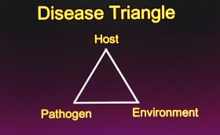
Plant Disease Triangle
Notes:
All three need to be present (ex’s)

Slide 9
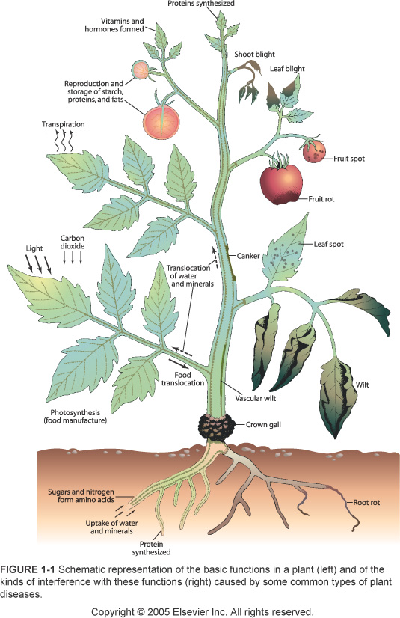
Basic Plant Functions vs. Plant Disease Interference
Notes:
Ex: root infection results in plant unable to absorb nutrients/water from the soil (Ted B)
Xylem vessel infection results in some vascular wilts/cankers
Infection of foliage results in decrease in Ps

Slide 10
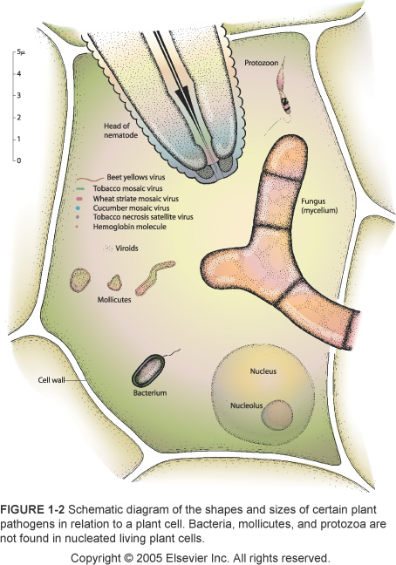
Certain Plant Pathogen Shapes & Sizes
Notes:
Tens of thousands of diseases affect cultivated & wild plants
Each kind of crop can be affected by a hundred or more plant diseases
Sometimes grouped according to symptoms (spots, etc), plant organ affected (roots, stems, etc), or crop types (field crops, veg, turf, etc)

Slide 11
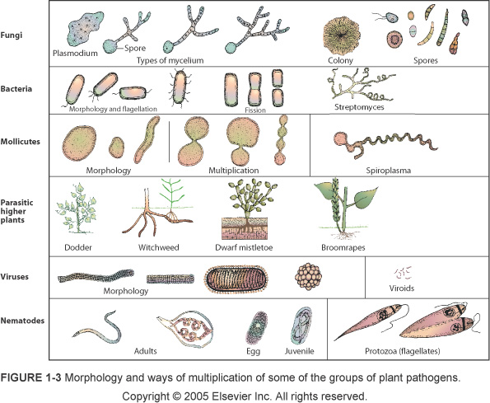
Groups of Plant Pathogens

Slide 12
Symptoms vs. Signs
Symptoms are the expression of disease by a plant as a response to a pathogen
Leaf spot, blight, canker, dieback, root rot, stem rot, scab, wilt, galls, leaf curls, etc.
Signs are structures or products of a pathogen on or in a diseased plant
Mycelium, sclerotia, fruiting bodies, spores
Notes:
Signs are distinct from symptoms, which refer only to the appearance of the infected plants or plant tissues
For examples, in mildews, one sees mostly the SIGNS consisting of a whitish, downy or powdery growth of fungal mycelium & spores on the plant leaves, fruit, or stem; whereas the SYMPTOMS consist of chlorotic or necrotic lesions

Slide 13
Plant Disease Classification, Agrios text
Infectious/biotic
Fungi
Prokaryotes (bacteria & mollicutes)
Parasitic higher plants
Viruses & viroids
Nematodes
Protozoa

Slide 14
Plant Disease Classification, Agrios text
Noninfectious/abiotic
Temperature
Soil moisture
Light
Oxygen
Air pollution
Nutrient deficiencies
Mineral toxicities
Soil pH
Pesticide toxicity
Cultural practices
Notes:
Too high, too low; excess or lack of

Slide 15
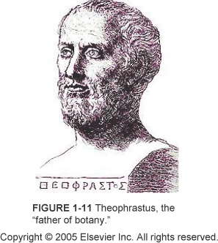
History
Homer
Mentioned therapeutic properties of sulfur
Theophrastus
“Father of Botany”
“Nature of Plants”
“Reasons of Vegetable Growth”
“Wrath of God”
Notes:
Pupil of Aristotle
2nd book mentioned diseases; lowland farmers vs highland, rust on cereals vs legumes

Slide 16
History
Bible
Mildews, blasts, blights
Romans
Feast of Robigalia
Repeated destruction of cereal crops by rusts and other diseases
Notes:
Rust epidemics
Romans set up new god and even established a special holiday for Robigus – offereings & sacrifices

Slide 17
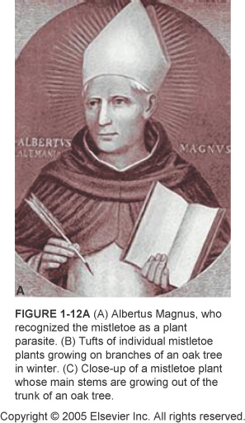
History
Mistletoe recognized as first plant pathogen
1200 AD – Albertus Magnus
Cultural control – remove infected branches
Notes:
MT’s are evergreen parasites that sink their “roots” (sinkers or haustoria) into tree branches
Absorb water, minerals
Why is this so important???

Slide 18
History
Outbreaks in north-central Europe of “ergotism”
Disease of humans and animals caused from eating grains contaminated with the parts of this fungus
Ergot epidemics (rye)
850 AD (“Holy Fire” & St. Anthony)
1690 AD (Salem with trials)
1670, Thoullier – observed was associated with consumption of infested grains
Robert Hooke – invented compound microscope
Notes:
Invention of the compound microscope – Robert Hooke

Slide 19
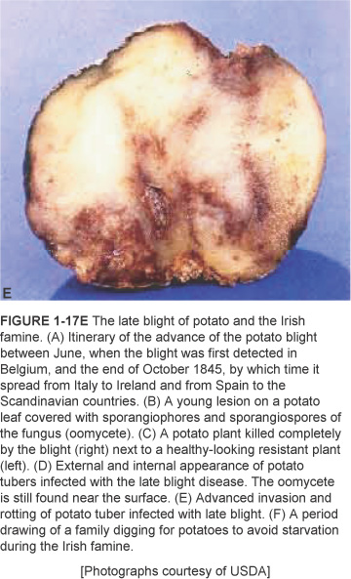
History
Late blight epidemics (potato)
1845 – Irish potato famine
Potato production favored by the cool, wet climate
Years of favorable production
Tubers stored for following season in ditches
Weather became cooler, wetter than usual
Potatoes in field and storage were affected
Followed by another season of favorable conditions for disease development
Phytopthora infestans
1861, Anton deBarry
Notes:
Winter production, began growing & eating potatoes to the exclusion of other food stuffs
deBarry finally proved that it was caused by a fungus by dusting spores onto a healthy set of potatoes; also disproved theory of “sponaneous generation” by showing infection in field came from fungus in storage

Slide 20
History
Koch’s postulates (Robert Koch, 1843-1910)
1st to show that anthrax was caused by a bacterium
Also tuberculosis, cholera
Suspected casual agent must be present in every diseased organism examined
Suspected casual agent must be isolated from diseased host and grown in pure culture
When a pure culture of the suspected casual agent is inoculated onto a susceptible host, the host must reproduce the specific disease
Same casual agent must be recovered again from the inoculated host and have the same characteristics

Slide 21
History
Bordeaux mixture
Mid 1800’s
Powdery mildew – Uncinula necator
1854, French wine production reduced by 80%
Pierre Alexis Millardet
Noticed bluish film on healthy rows
Copper sulfate mixed with some hydrated lime
Refined mixture back at lab, proved to be an excellent fungicide and bactericide for more than 100 yrs
1900’s-2000’s
DDT, Carson, Borlaug, Methyl Bromide ban, end of cheap oil

Slide 22
Resources
Texts
Agrios
Others
Compendia
APS net
Compilation – Index of Plant Diseases in FL
Literature
Notes:
Agrios-11 different languages!

